Slide 1
Cse 424 -paper review
By
Tanvir Islam Sayem
Id:20301360

Slide 2
Pattern recognition and features selection for speech emotion recognition model using deep learning
By
Kittisak Jermsittiparsert1 · Abdurrahman Abdurrahman2 · Parinya Siriattakul3 · Ludmila A. Sundeeva4 · Wahidah Hashim5 · Robbi Rahim6 · Andino Maseleno7

Slide 3
Introduction
Importance of communication between humans and machines
Utilizing voice commands for various applications
Recognizing speaker characteristics and emotions
Impact of emotional state in human-computer interaction
Using speech emotion recognition in various fields

Slide 4
Background
speech emotion recognition models
Selection of features and classification methods
Challenges in real-time deployment
The significance of input quality in classifier accuracy
- Utilizing the Berlin database with 500 media person demonstrations

Slide 5
Proposed Deep Learning Model
method for speech emotion recognition using deep learning, specifically a pre-trained CNN model known as ResNet 34.
ResNet 34 is trained on the ImageNet dataset, consisting of over one million images in 1000 categories, and it is recognized for its efficiency and adaptability across various databases.
The text discusses the use of deep neural networks (DNN), emphasizing the configuration of these networks, including the number of hidden layers, activation functions, and neuron counts, with a focus on optimization for better classification accuracy.
Rectified Linear Unit (ReLU) activation functions and softmax functions are mentioned in the context of DNN, and the text briefly explains the softplus function, providing equations for these functions.
The text outlines the steps involved in the DNN training process, from loading datasets and constructing the classifier to fitting the model and evaluating its accuracy. It also hints at additional deep learning techniques like finding the optimal learning rate, fine-tuning, and data augmentation to improve model performance.

Slide 6
Proposed Deep Learning Model-Augmentation
Data augmentation
Optimal learning rate finder
Stochastic gradient descent with restarts (SGDR
Fine‑tuning

Slide 7
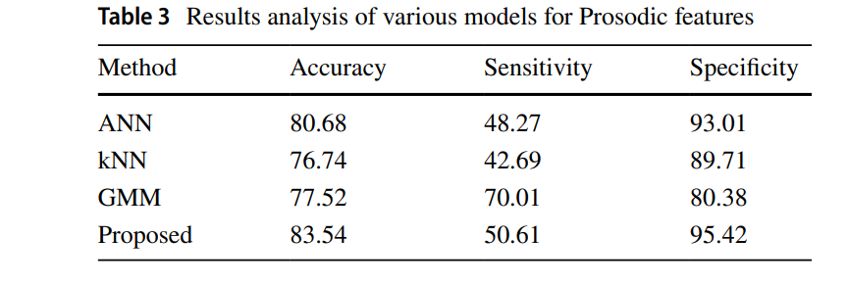
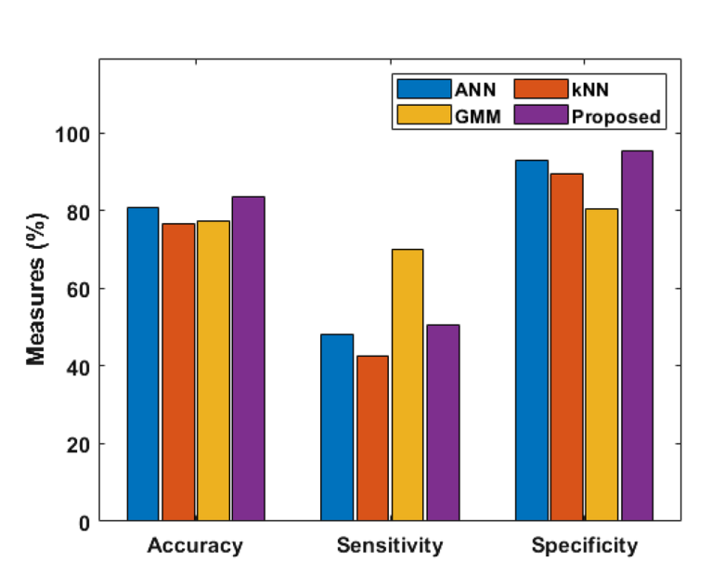
Performance evaluation

Slide 8
Conclusion
The deep learning model that is being presented shows significant advancements in speech emotion identification, outperforming more conventional techniques like kNN and GMM and attaining high accuracy rates. The model's hopeful implications for practical applications stem from its ability to accurately recognize emotional states in human speech.

Slide 9
Thank you

